Slide 1



Internship Report
AI (LLMs, GenAI, Agent AI)
IIT Jammu & Techible
Notes:
1

Slide 2
Internship Objectives
🎯 AI Fundamentals
🚀 Build & Deploy
Gained foundational and advanced understanding of LLMs, automation workflows, and cutting-edge AI technologies, including their theoretical underpinnings and practical applications.
Learned to build and deploy robust AI-powered applications using modern tools and frameworks, focusing on scalability and real-world utility.
⚙️ Technical Skills
🤝 Professional Growth
Developed expert-level proficiency in APIs, webhooks, and advanced workflow automation platforms, crucial for integrating AI solutions into existing systems.
Strengthened critical problem-solving, collaborative teamwork, and efficient project execution capabilities within a dynamic technical environment.
Notes:
2

Slide 3
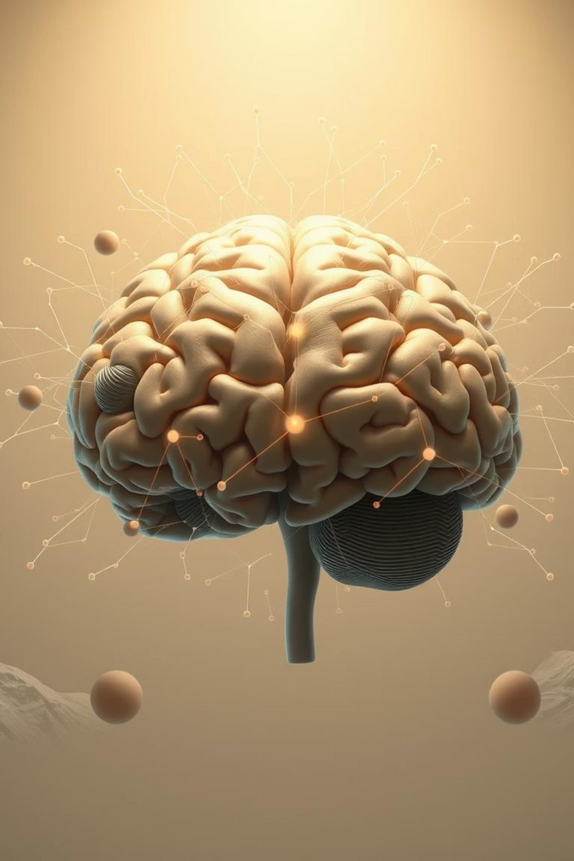
Key Learnings
This internship provided a comprehensive dive into the evolving landscape of AI, transforming theoretical knowledge into practical expertise. I gained insights into architecting intelligent systems and optimizing their performance for diverse applications.
Notes:
3

Slide 4
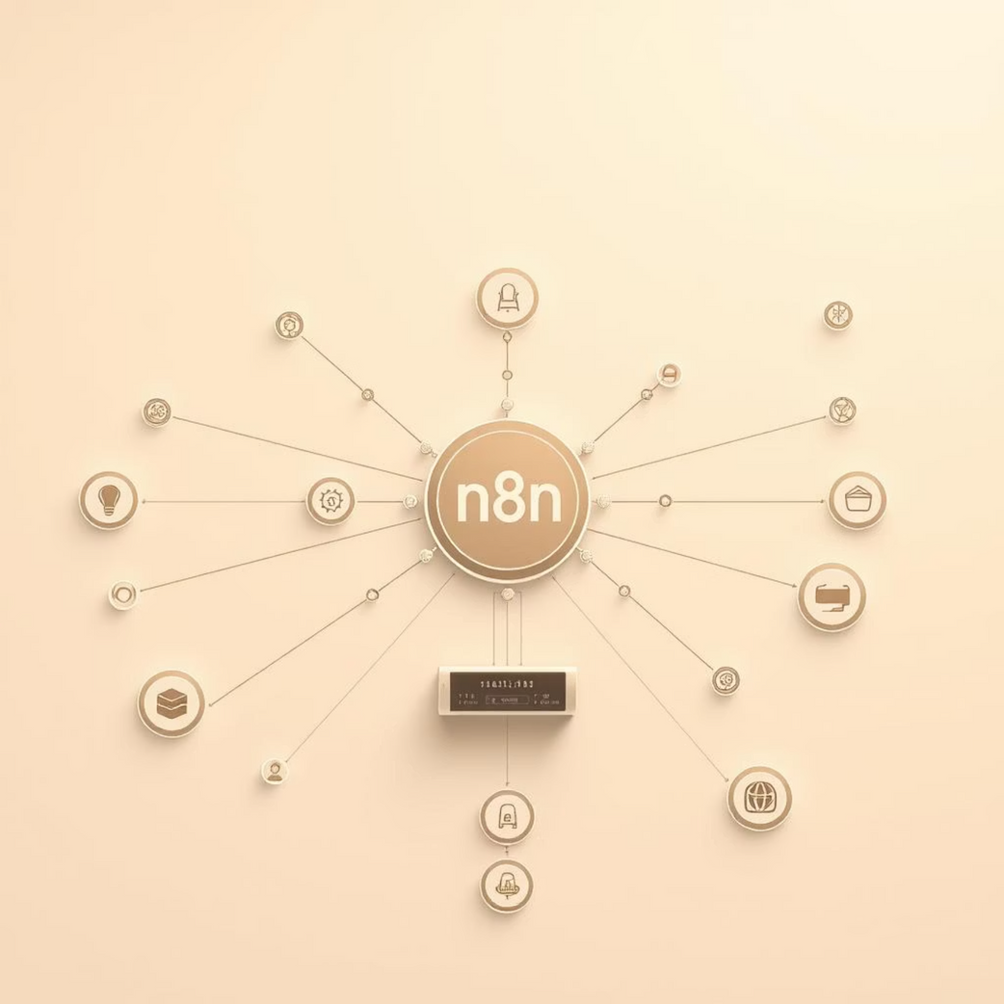
Projects & Work Done
Multi-Agent Workflows
OpenAI & CrewAI Agents
Built sophisticated automation systems with n8n, orchestrating multiple AI agents across different workflows for comprehensive data analysis and intelligent decision-making.
Designed and deployed advanced AI agents for text-based tasks including summarization, translation, and intricate question-answering systems using OpenAI's powerful models.
Implemented a comprehensive multi-agent system with CrewAI to optimize freelancer gig workflows, enabling intelligent task allocation, coordination, and automated progress tracking.
Notes:
4

Slide 5








Skills Acquired
Python Programming
Workflow Automation
Advanced proficiency with asyncio for asynchronous operations, pandas for data manipulation, and various ML frameworks for model development.
Expert-level n8n skills, integrating powerful AI services like Gemini, WhatsApp, and Telegram for seamless automation.
AI Tools Mastery
Deep Learning
Hands-on experience with OpenAI, Hugging Face, Gradio for interfaces, Canva for design, FreeTTS for speech synthesis, and Ollama for local LLM deployment.
Practical implementation of RNN, CNN, LSTM, GRU, and Transformer architectures, understanding their strengths and applications.
Time Management
Team Collaboration
Developed effective strategies for managing multiple complex AI projects simultaneously, ensuring timely delivery and optimal resource allocation.
Enhanced ability to work efficiently in cross-functional teams, leveraging version control (Git) and collaborative development tools.
Presentation Skills
Professional Networking
Improved clarity and conciseness in communicating complex technical concepts to diverse audiences.
Actively engaged in LinkedIn networking, expanding professional connections within the AI and tech industry.
Notes:
5

Slide 6
Challenges & Solutions
1
2
🔧 Workflow Complexity
🔌 API Integration
Challenge: Designing intricate automation workflows with multiple data sources and interdependent AI agents.
Challenge: Navigating various API integration issues, including authentication protocols, rate limiting, and data format discrepancies.
Solution: Adopted modular design principles, breaking down complex workflows into smaller, manageable sub-workflows. Utilized n8n's visual builder for clearer orchestration and debugging.
Solution: Implemented robust error handling, retries, and exponential backoff mechanisms. Thoroughly reviewed API documentation and leveraged community forums for troubleshooting specific endpoint behaviors.
3
4
⚖️ Theory vs. Practice
🔄 Multiple Technologies
Challenge: Balancing theoretical understanding of AI models with their practical implementation and real-world limitations.
Challenge: Simultaneously learning and integrating a diverse array of new technologies and frameworks.
Solution: Engaged in extensive hands-on coding and experimentation, often starting with simplified prototypes. Regularly sought feedback from mentors to bridge the knowledge gap and refine practical approaches.
Solution: Prioritized learning based on project requirements, focusing on core functionalities first. Utilized official documentation, online courses, and peer-to-peer learning sessions to accelerate skill acquisition.
Notes:
6

Slide 7
Key Takeaways
🛠️ Hands-on AI Experience
📊 Project Workflow Understanding
Gained invaluable practical experience with cutting-edge AI tools and platforms, directly contributing to innovative solutions and understanding industry trends.
Acquired comprehensive insight into the entire AI project lifecycle, from initial problem identification and ideation to development, testing, and successful solution deployment.
🚀 Enhanced Capabilities
💪 Independent Confidence
Achieved significant improvement in both specialized technical skills and crucial professional soft skills, positioning myself for greater success in future industry roles.
Developed profound confidence in my ability to systematically approach and independently solve complex AI problems, fostering a strong sense of self-reliance and initiative.
Notes:
7

Slide 8

Conclusion
"A Transformative Journey"
This six-week internship at Techible, in collaboration with IIT Jammu, successfully bridged the gap between academic learning and practical industry application in advanced AI technologies. It was a period of intense growth, practical innovation, and significant personal development.
Notes:
8

Slide 9
Thank You
For your time and consideration.
Notes:
9

